Slide 1


Updates on Global Gaps in Alien Plant Traits
Monday September 5th
Matthias Grenié, GloNAF folks, Ingolf Kühn, Marten Winter
@LeNematode
https://rekyt.github.io/

Slide 2
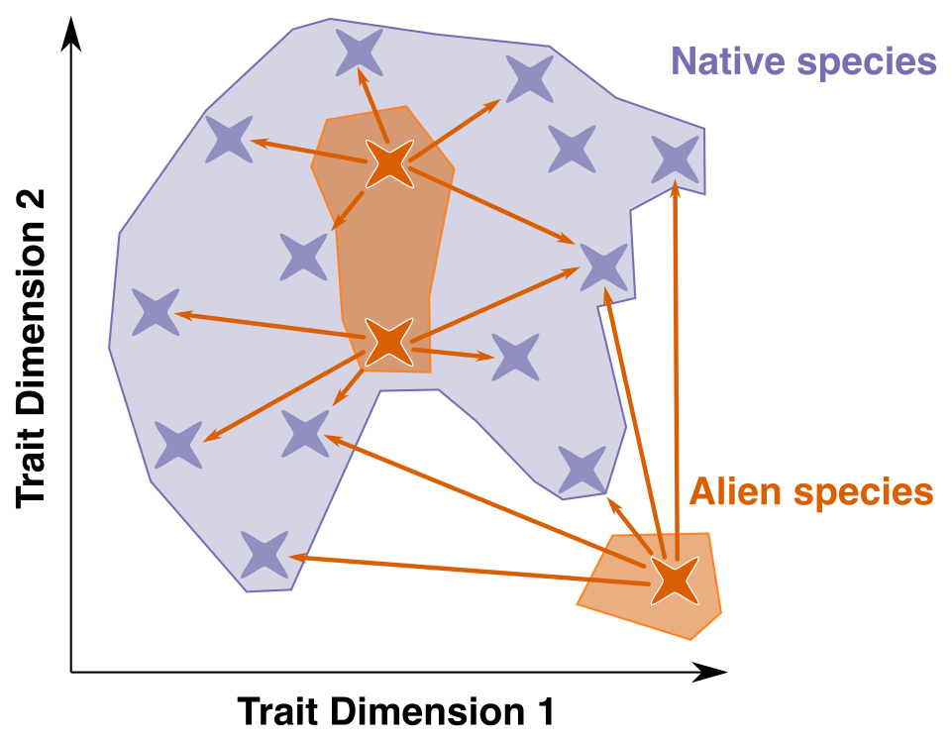
(Tiny) Introduction
Functional Position of Aliens
We want to study functional biogeography of aliens
Always facing lack of trait data
Systematically study gaps in trait data
<number>

Slide 3





Brief Methodological Summary
(Open) Trait Data
Alien status and distribution
Taxonomic Harmonization + Trait Harmonization + Trait Categorization
16 538 species from GloNAF → 15 490 species with at least one trait (consolidated data)
<number>

Slide 4
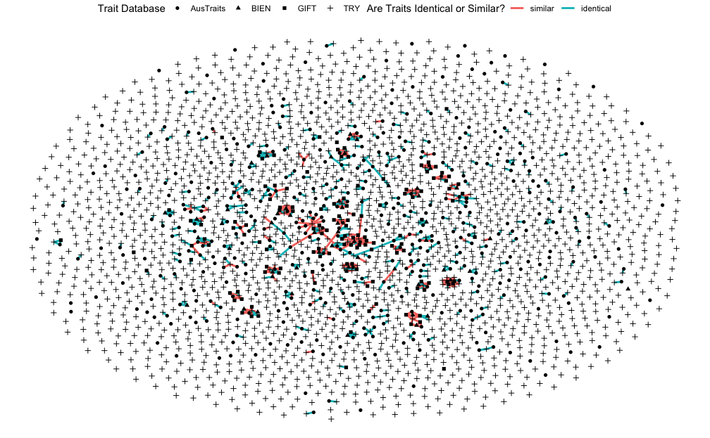
Step aside regarding trait harmonization
Trait Harmonization is no easy task
Had to manually build correspondence tables between databases
→ Results in a trait network
1 node = 1 trait name
1 edge = identical or similar traits
One connected component = one “group of traits” across databases
→ Will present this idea to DB managers to see if publishable
<number>

Slide 5
Step aside regarding trait categorization
Species (15,459) x Trait (2,215) matrix is too big to be really informative
Reduce complexity by testing for combinations of traits (also has more ecological sense)
LHS (Westoby et al. 1999) 3 traits
Aboveground Traits (Díaz et al. 2016) 6 traits
Root Traits (Bergmann et al. 2020) 4 traits
<number>

Slide 6
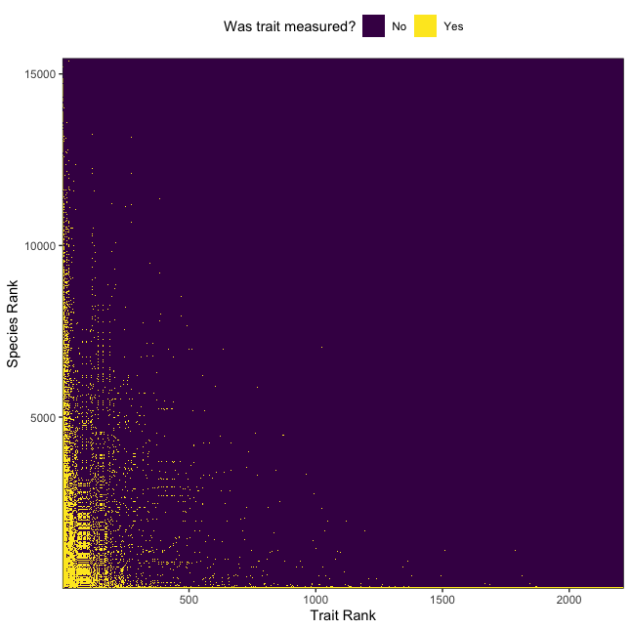
Global availability of traits
As expected trait matrix is mostly empty (98%)
<number>

Slide 7
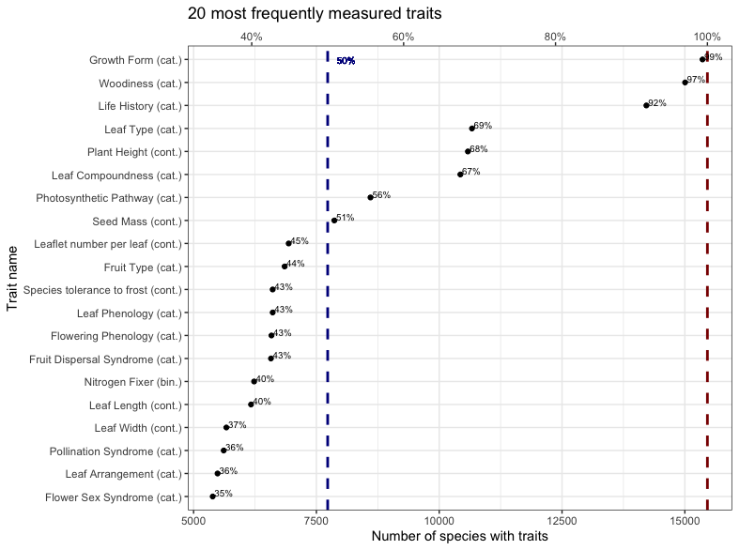
20 most measured traits are mostly categorical
Most traits measured for <50% of species
Plant height is the first continuous trait
Available for ~70% of species
Seed mass is the second continuous trait
Available for ~50% of species
<number>

Slide 8
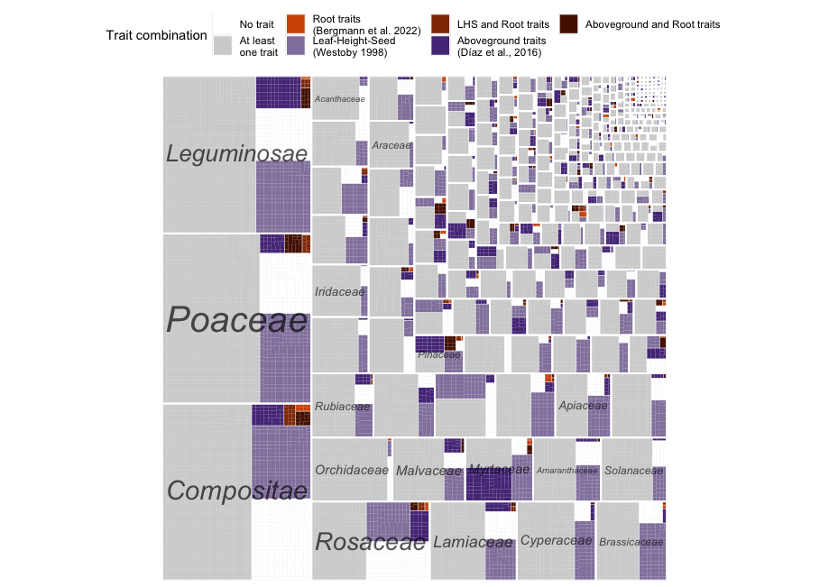
Distribution of Combinations of Traits per Taxonomic Family
1 pixel = 1 alien species
1 white rectangle = 1 Family
Family ordered by number of alien species (left to right, bottom to top)
Many species with ≥1 trait (~90% of species)
Some families have high proportion of Aboveground Traits (deep purple) (like Myrtaceae/Pinaceae)
<number>

Slide 9
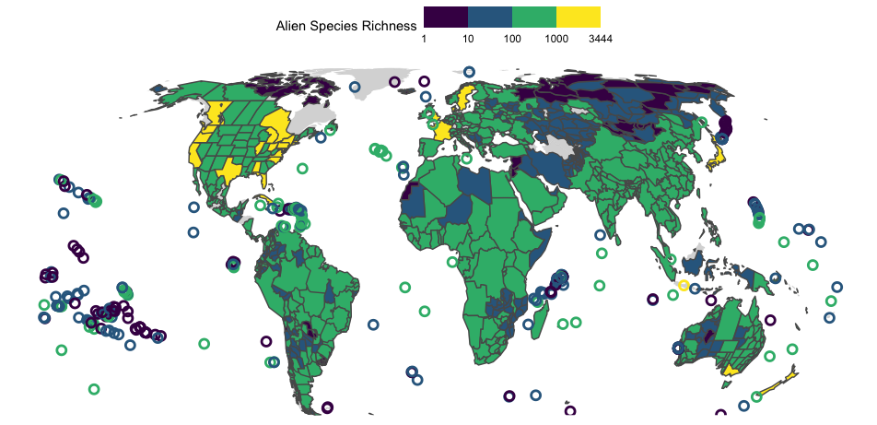
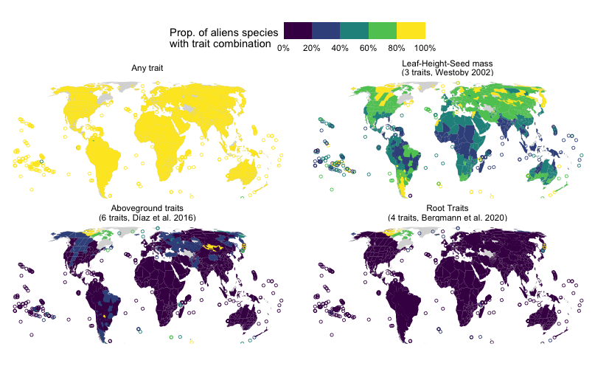
Geographic distribution of Trait Availability
Tropics have <60% alien species LHS
High latitude & islands show >80% prop. LHS
Other combinations are not so known in proportion
<number>

Slide 10
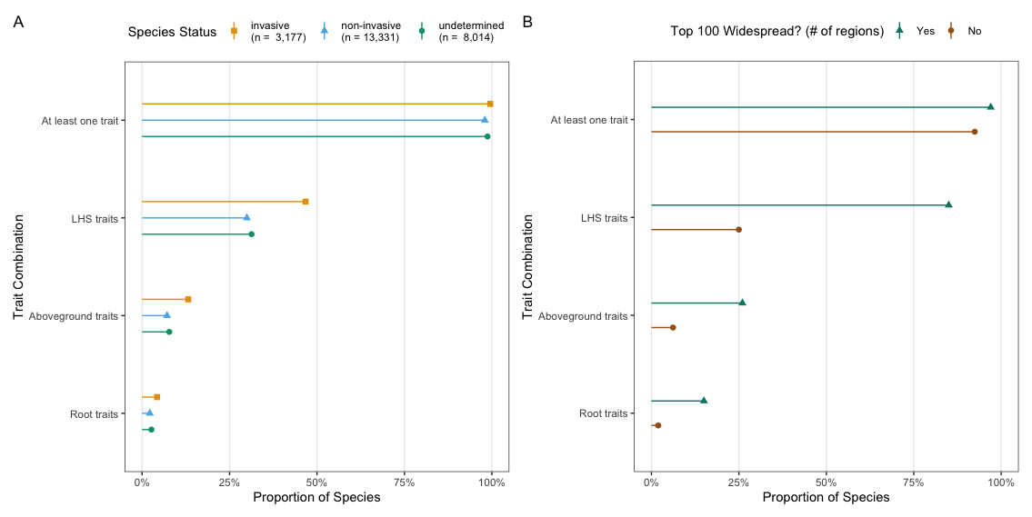
Invasive and widespread species are better known
<number>

Slide 11
Perspectives
So many trait gaps → prevents general overview (even only in Europe) (even being large in trait definition + no check of provenance of trait data)
Need to close trait gaps
Literature (not working so well according to our experience)
Floras (already in GIFT!)
Remote sensing?
Distributed call for data (LT-Brazil & FunAndes = seems to work)
Distributed field campaign
Traits from herbarium?
Not even talking about the provenance of traits (native vs. alien range) → can do a subanalysis on trait with coordinates but not so informative IMHO
Relevant traits for invasion functional biogeography? (What trait-environment relationship would you like to see?)
<number>

Slide 12
Questions to you
Is there any big figure missing in these analyses?
Any other suggestion of relevant trait combination?
How should we point forward to close the gaps?
Should we focus on other area to close some gaps? (for now 10 most widespread species in Europe lacking 1 of any LHS trait)
<number>

Slide 13
Thank you!
<number>

Slide 14
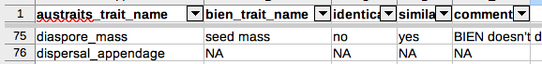
“Aligning” trait databases in practice
Heavily inspired by the work of Elizabeth Wenk on AusTraits (Thanks again!)
Manually build correspondence table between each pair of databases (apart from AusTraits ↔ TRY)
Records:
Two database Trait IDs/Trait Names
If trait are identical (exactly same meaning)
If traits are similar
Additional comments
~1 person in 1-2 days
424 traits in AusTraits
54 traits in BIEN
133 traits in GIFT
2091 traits in TRY
<number>
Notes:
To do so I used 4 trait databases (AusTraits, BIEN, GIFT, and TRY).
However I needed to combine them to get a complete overview so I had to merge all datasets.
Fortunatelt Lizzy Wenk had done the tedious job between AusTraits and TRY (with many information regarding similarity of traits/units/organs, etc.).
I did the same for all pairs of databases. AusTraits has XX traits, BIEN YY, GIFT ZZ, and TRY AA In total I matched traits if they were identical (same meaning, same unit) or similar. I’ve built a network of trait names across databases. One connected component is a group of “similar” traits.

Slide 15
“Aligning” trait databases in practice: Example table
bien_trait_name | try_trait_id | try_trait_name | identical | similar | comments
diameter at breast height (1.3 m) | 21 | Stem diameter | yes | yes | NA
fruit type | 99 | Fruit type | yes | yes | NA
leaf area | 3108 | Leaf area (in case of compound leaves: leaf, petiole excluded) | no | yes | Leaf area in BIEN doesn’t specify if it is measured on leaflet or with/without petiole
leaf area | 3109 | Leaf area (in case of compound leaves: leaflet, petiole excluded) | no | yes | Leaf area in BIEN doesn’t specify if it is measured on leaflet or with/without petiole
<number>
Notes:
To do so I used 4 trait databases (AusTraits, BIEN, GIFT, and TRY).
However I needed to combine them to get a complete overview so I had to merge all datasets.
Fortunatelt Lizzy Wenk had done the tedious job between AusTraits and TRY (with many information regarding similarity of traits/units/organs, etc.).
I did the same for all pairs of databases. AusTraits has XX traits, BIEN YY, GIFT ZZ, and TRY AA In total I matched traits if they were identical (same meaning, same unit) or similar. I’ve built a network of trait names across databases. One connected component is a group of “similar” traits.

Slide 16
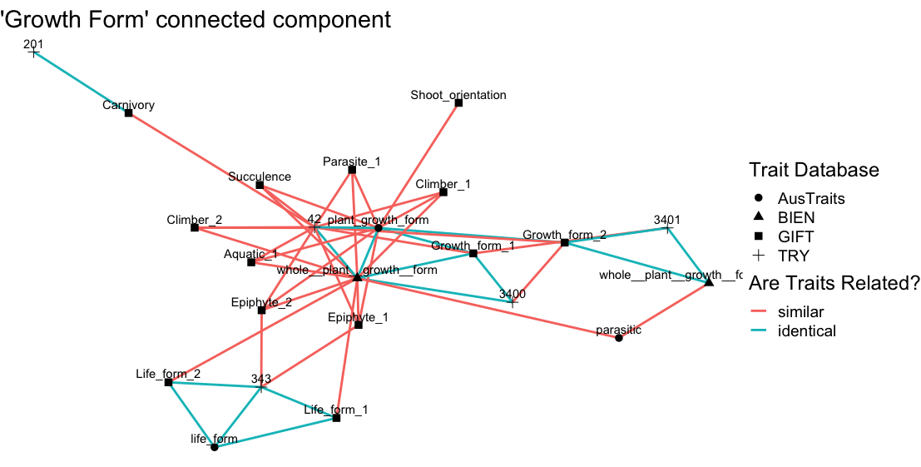
Zooming in the trait network
Plant nutrition mode (heterotrophy)
Detailed growth form
Life form traits
<number>
Notes:
To do so I used 4 trait databases (AusTraits, BIEN, GIFT, and TRY).
However I needed to combine them to get a complete overview so I had to merge all datasets.
Fortunatelt Lizzy Wenk had done the tedious job between AusTraits and TRY (with many information regarding similarity of traits/units/organs, etc.).
I did the same for all pairs of databases. AusTraits has XX traits, BIEN YY, GIFT ZZ, and TRY AA In total I matched traits if they were identical (same meaning, same unit) or similar. I’ve built a network of trait names across databases. One connected component is a group of “similar” traits.

